Slide 1
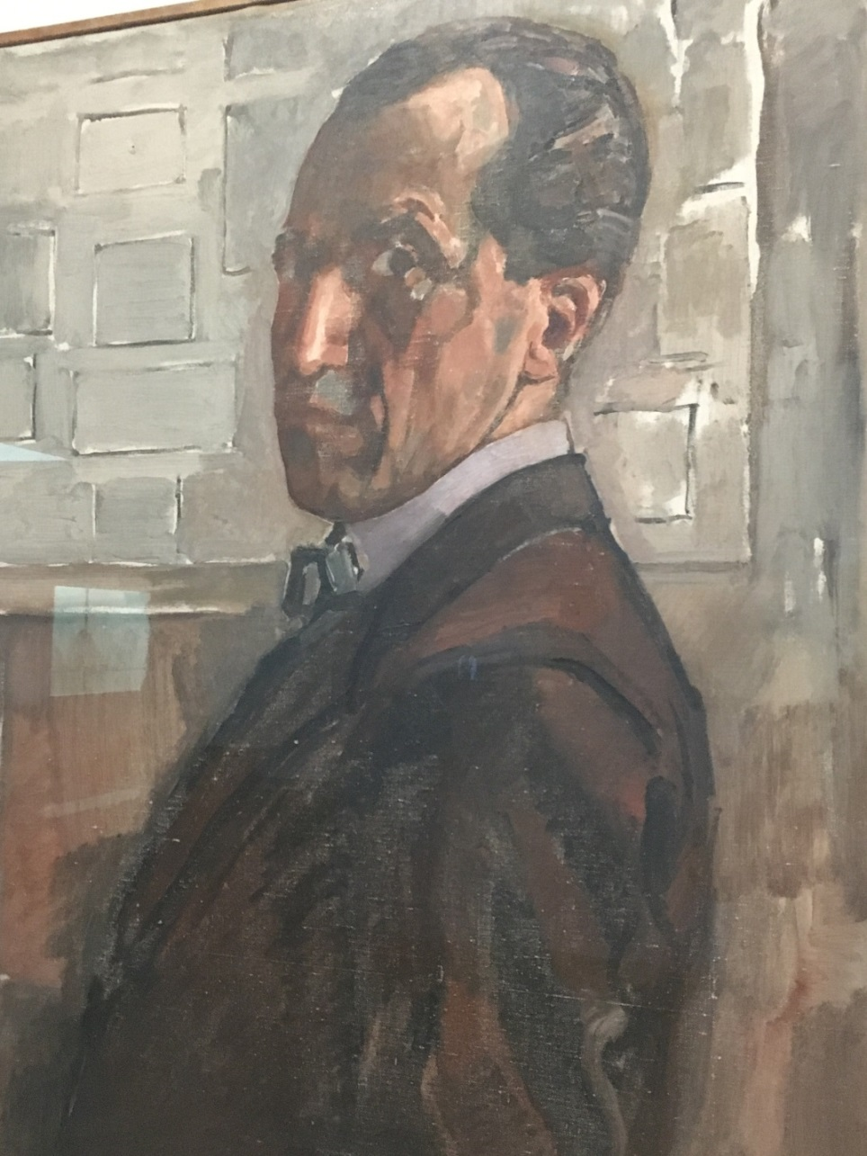
Piet Mondrian
1872 - 1944
John Bailie
3 August 2017
1918: Self-portrait

Slide 2
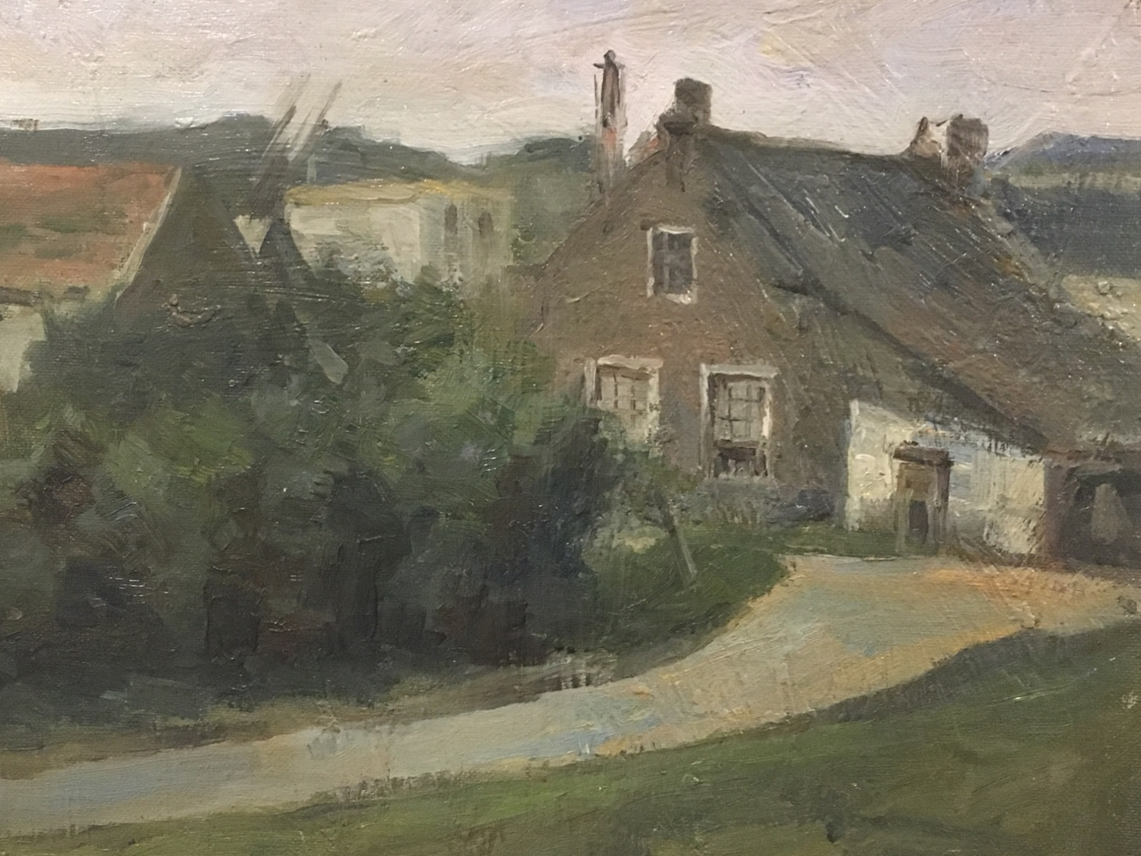
1899-06: One of several sketches in oil (1)

Slide 3
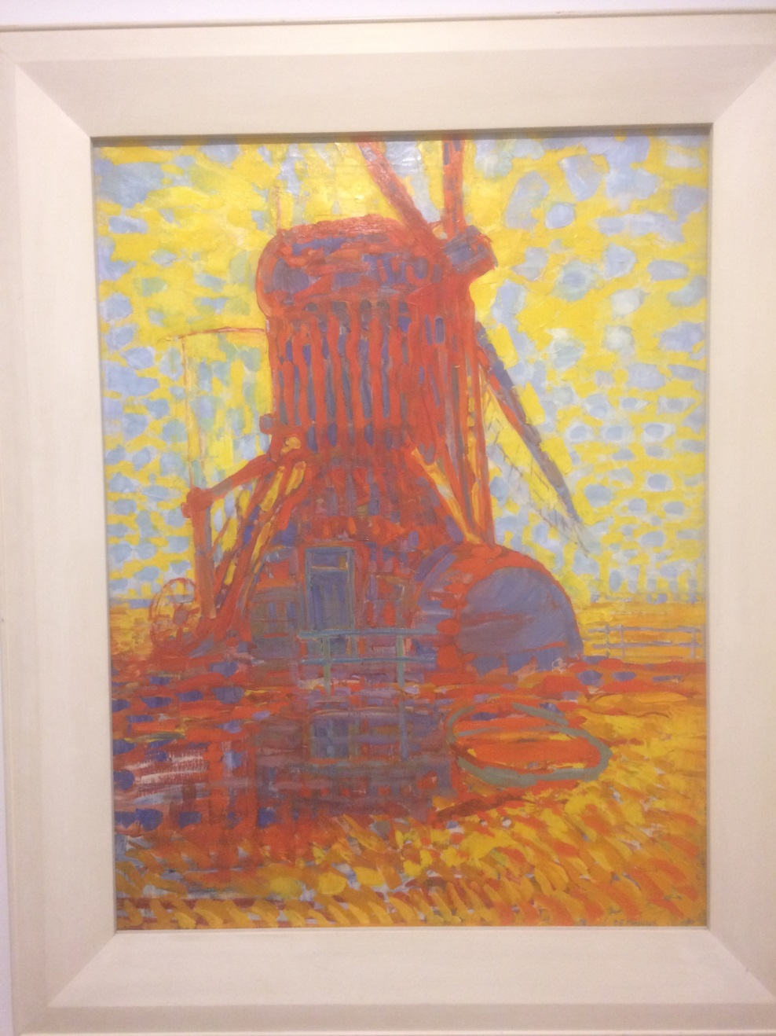
1908: Mill in sunlight

Slide 4
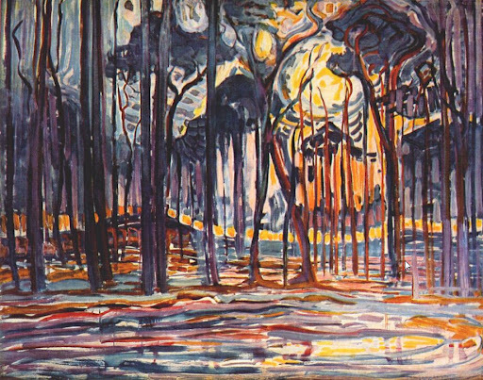
1908: Woods near Oele

Slide 5
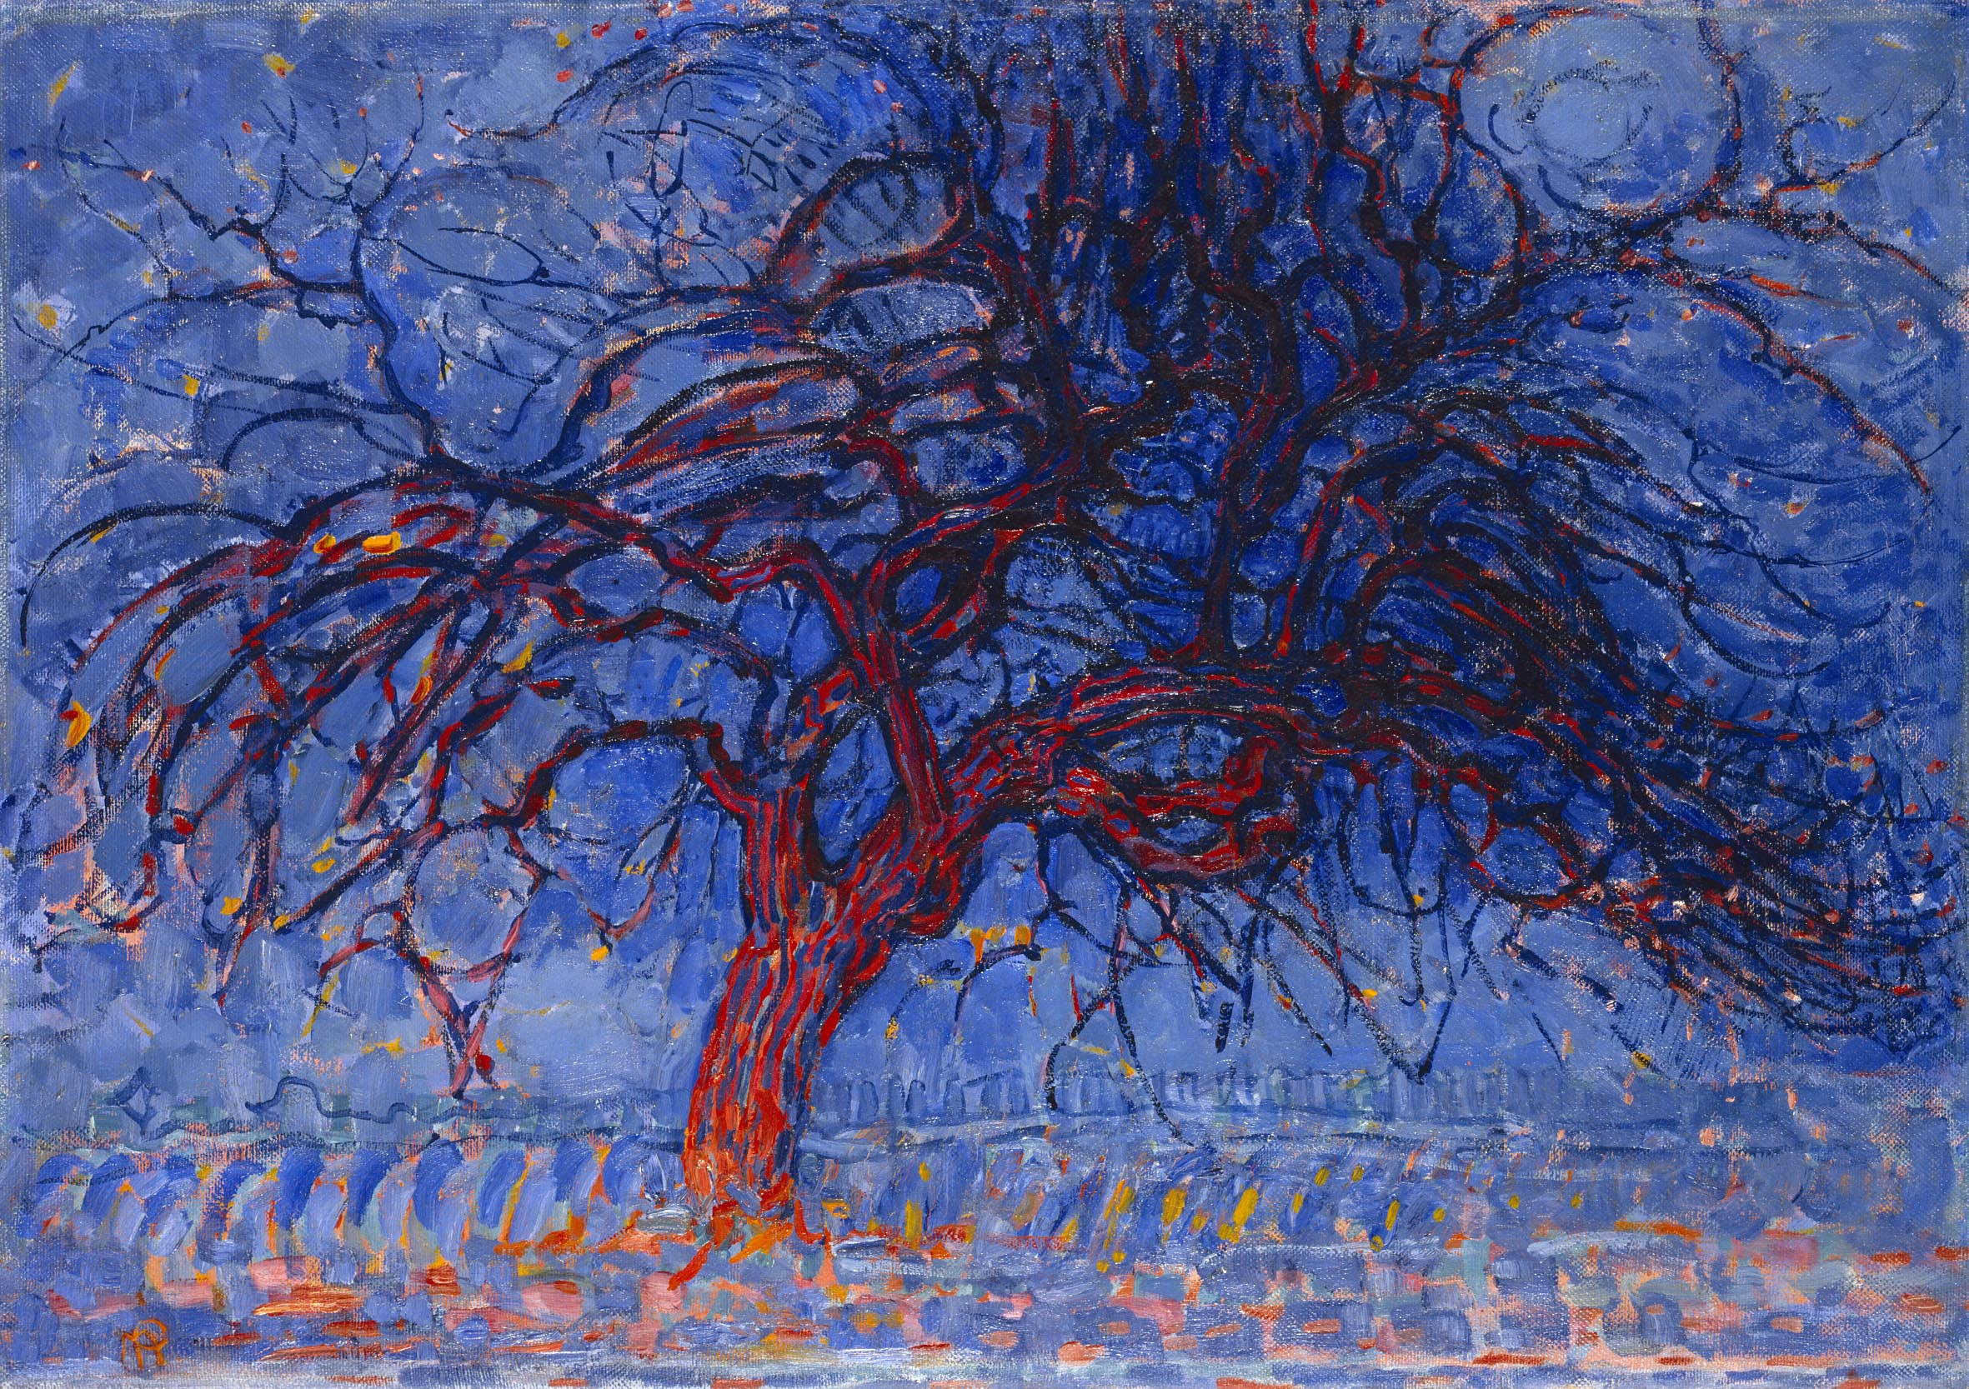
1908-10: Evening - Red Tree

Slide 6
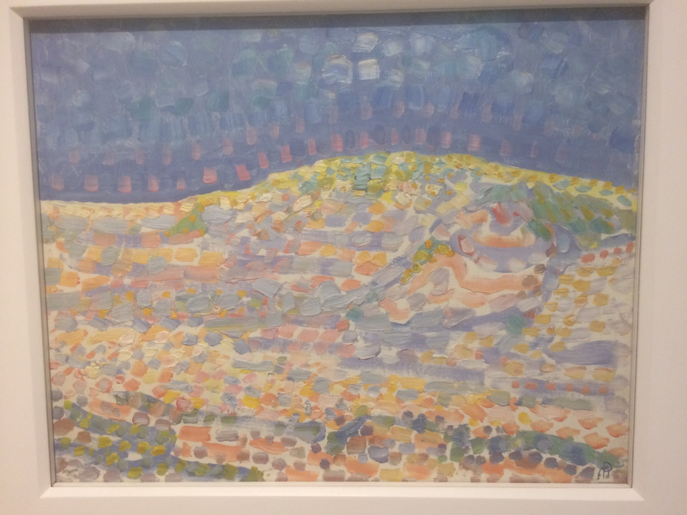
1909: Dune II

Slide 7
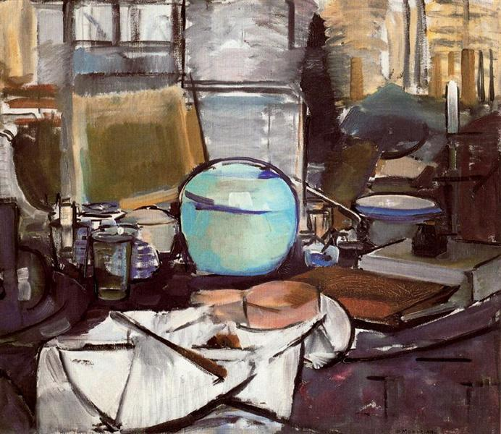
1911: Still Life with Gingerpot I

Slide 8
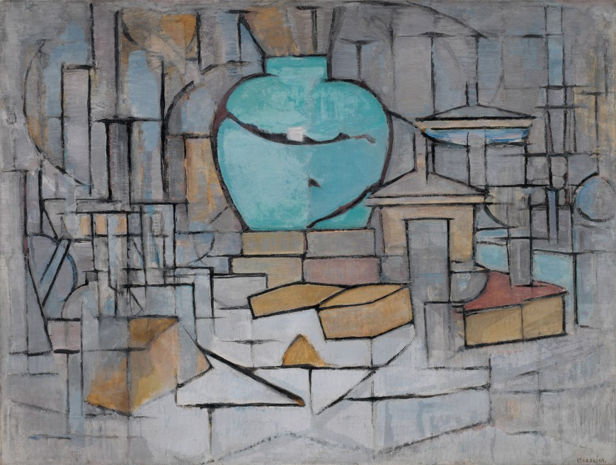
1912: Still Life with Gingerpot II

Slide 9
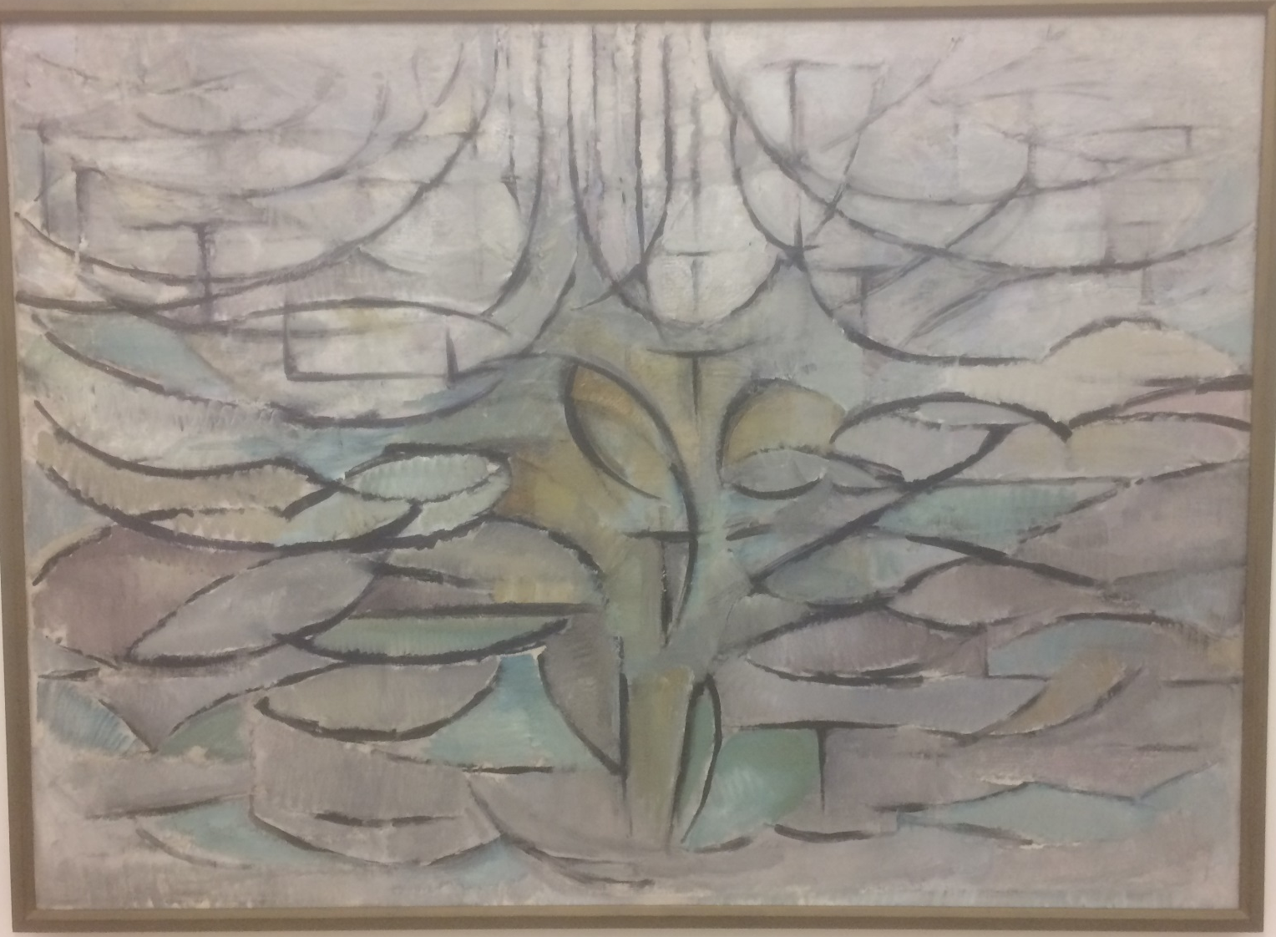
1912: Flowering apple tree

Slide 10
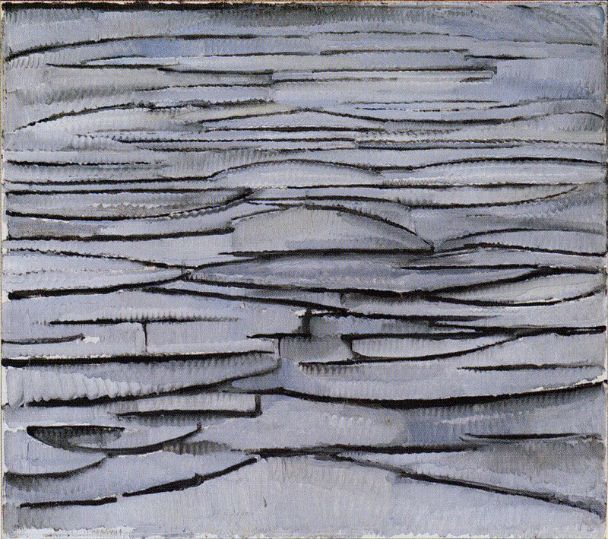
1912: The sea

Slide 11
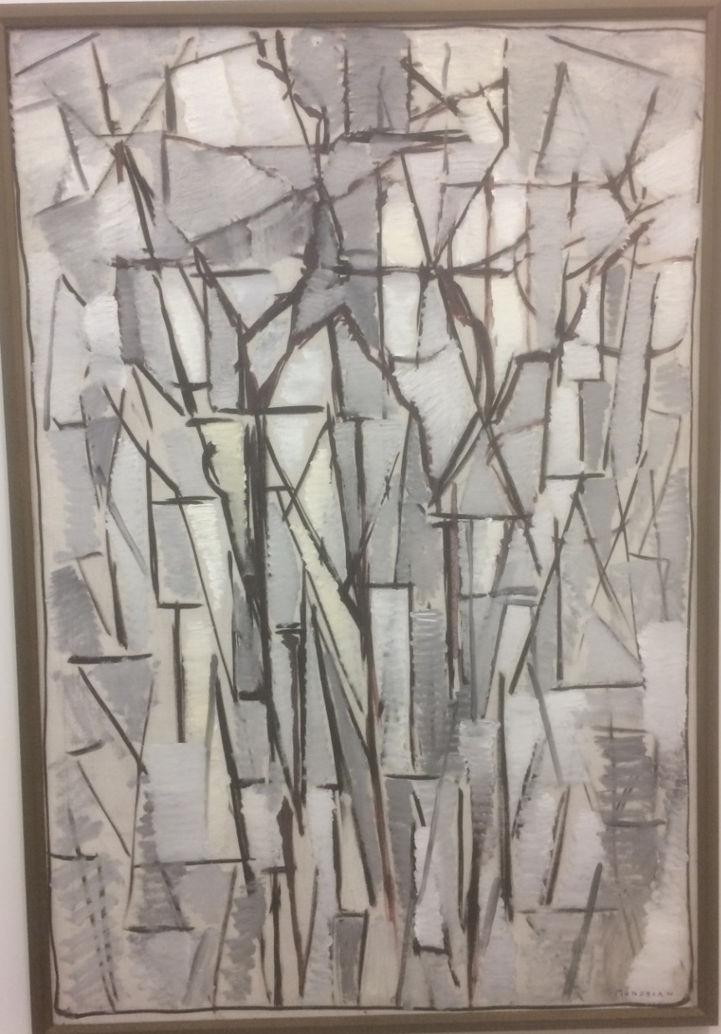
1912-13: Composition of trees 2

Slide 12
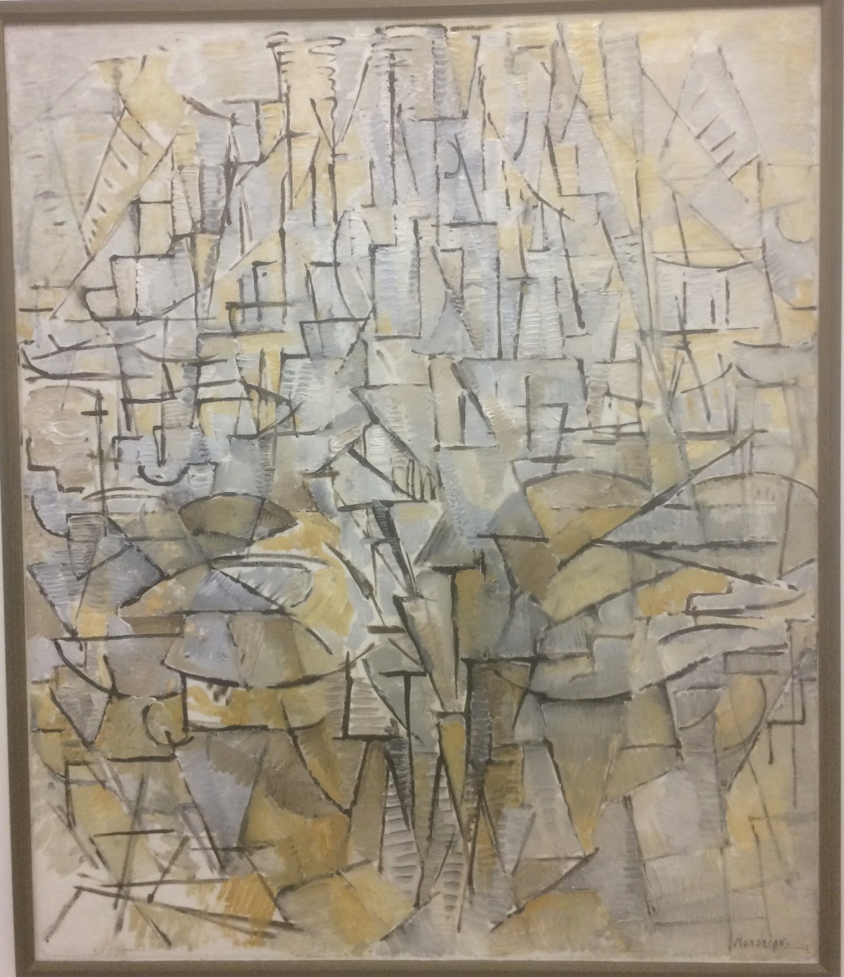
1913: Tableau No. 4, Painting No. 4

Slide 13
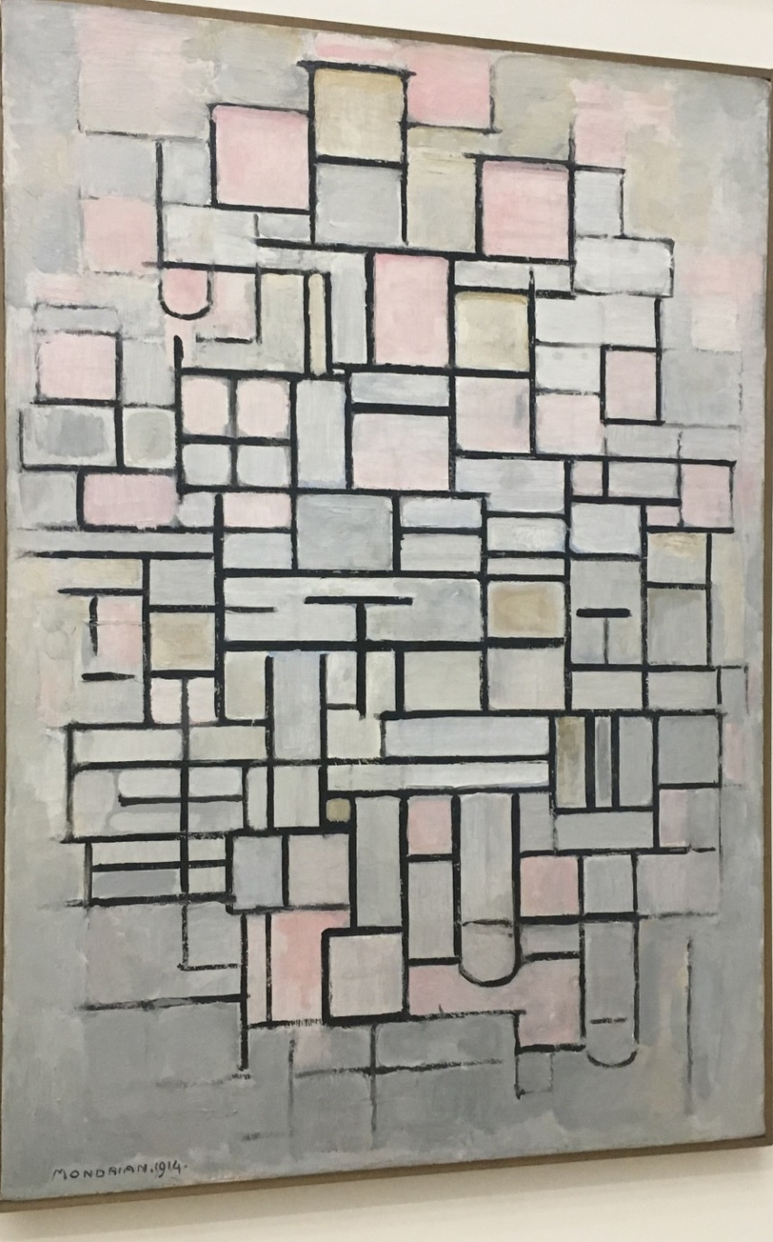
1914: Composition No IV - Compositie 6

Slide 14
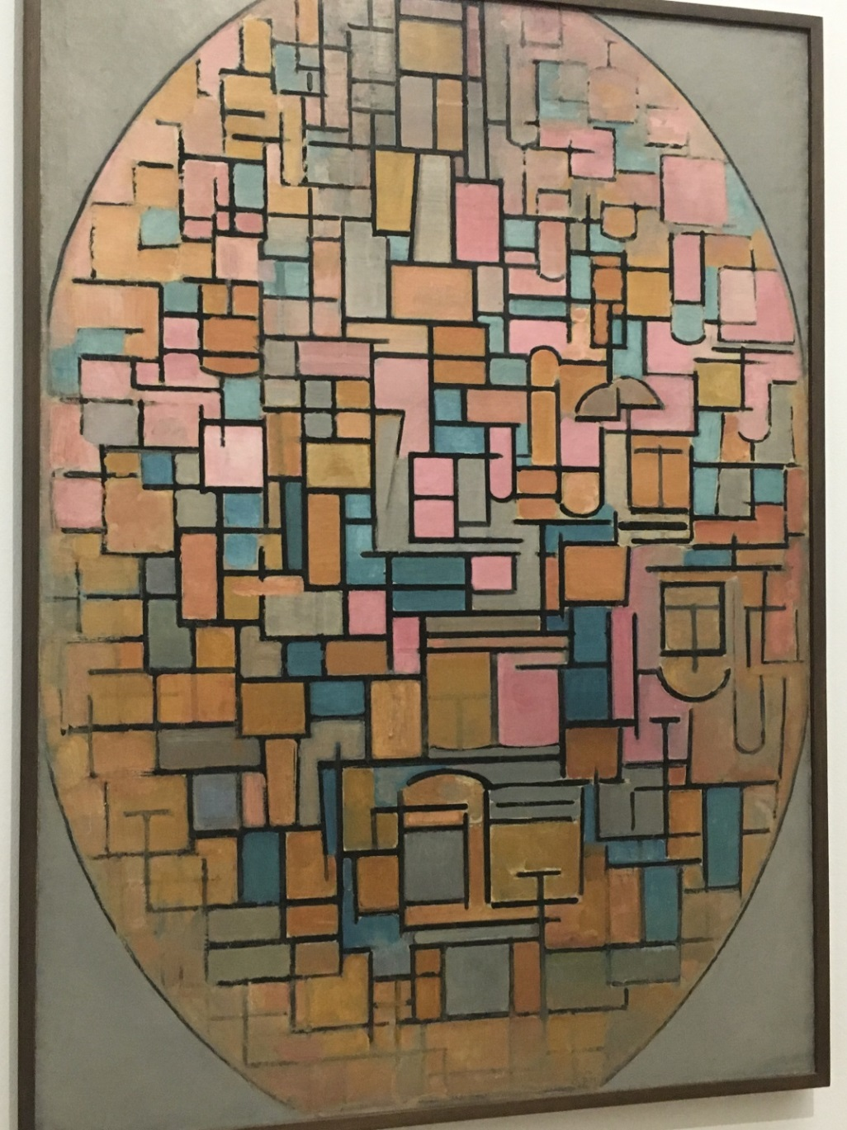
1914: Tableau III - Composition in oval

Slide 15
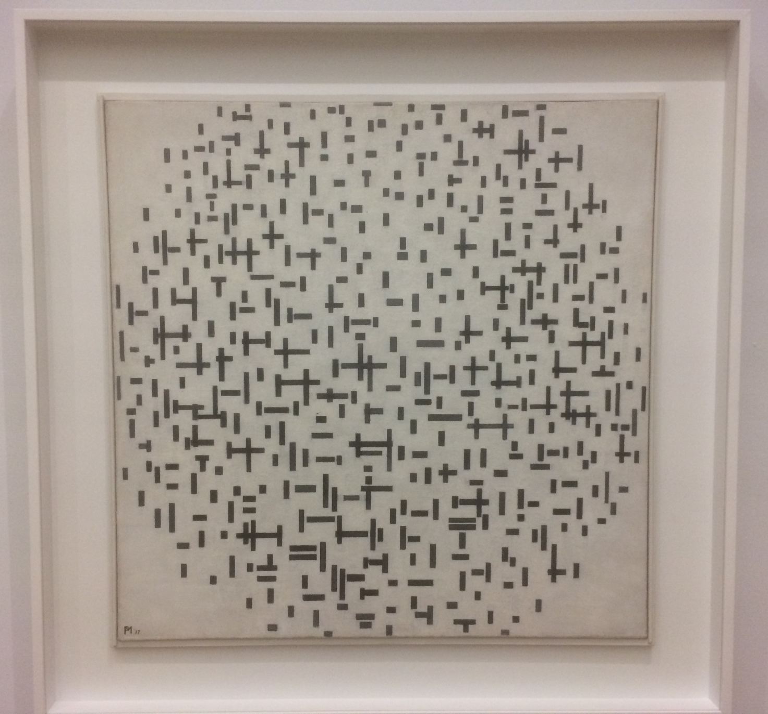
1916-17: Composition in line

Slide 16
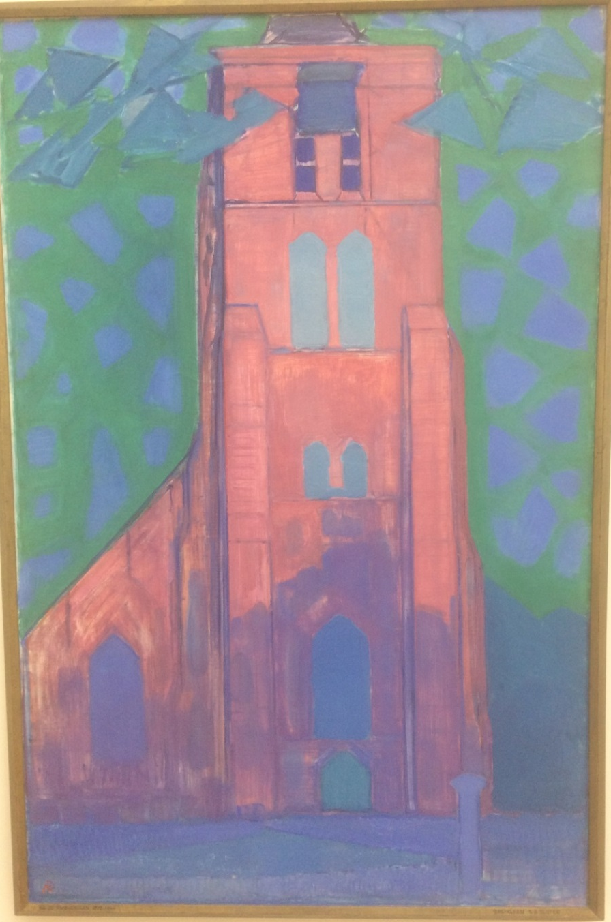
1911: Church tower at Domburg

Slide 17
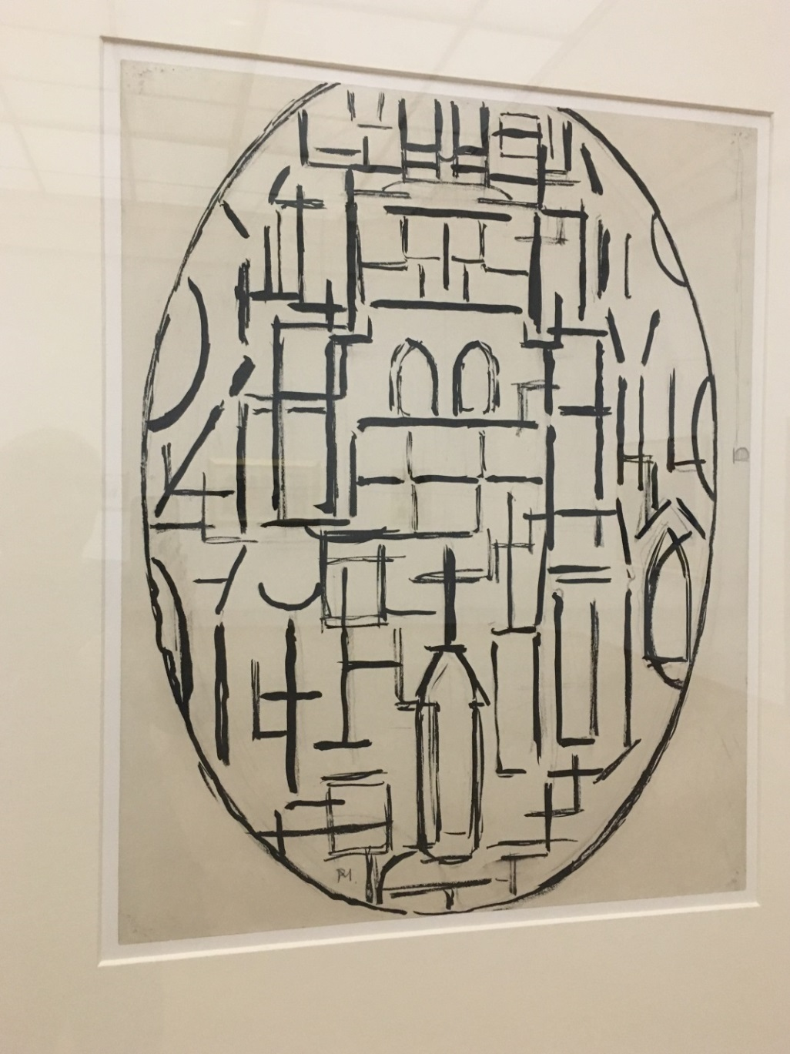
1914: Church facade - Church at Domburg

Slide 18
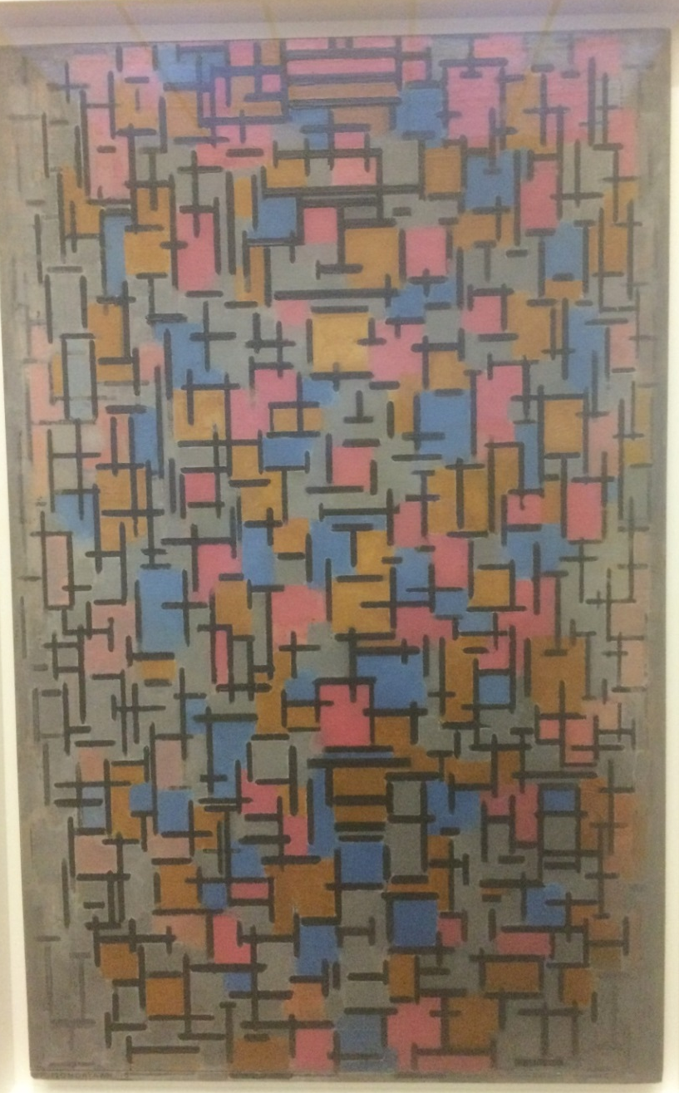
1916: Composition

Slide 19
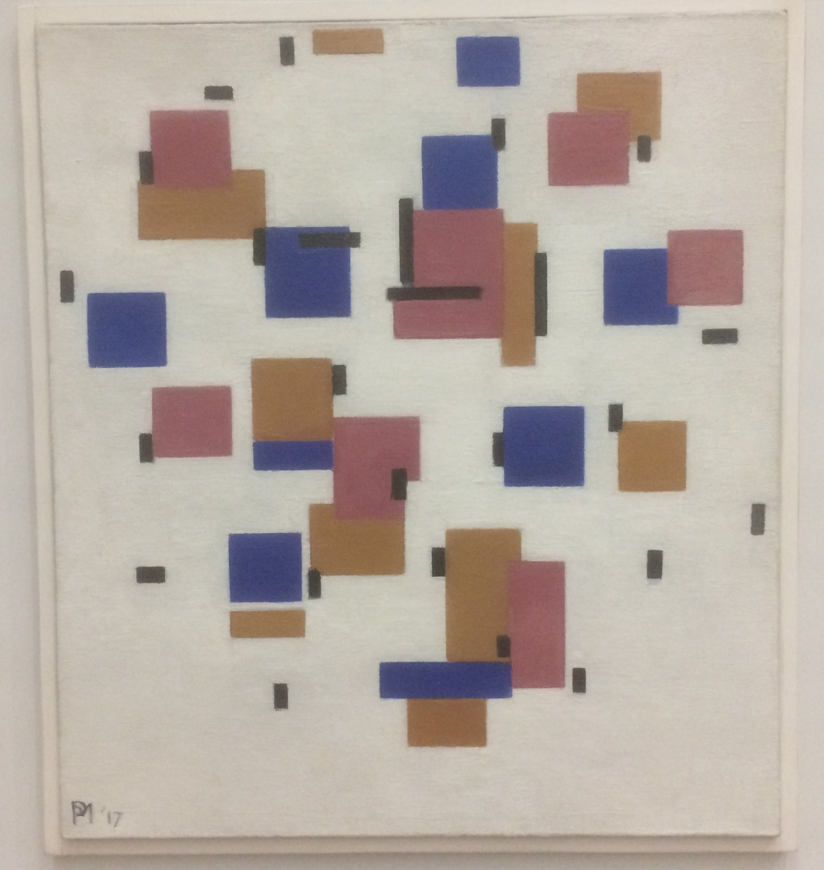
1917: Composition in colour B

Slide 20
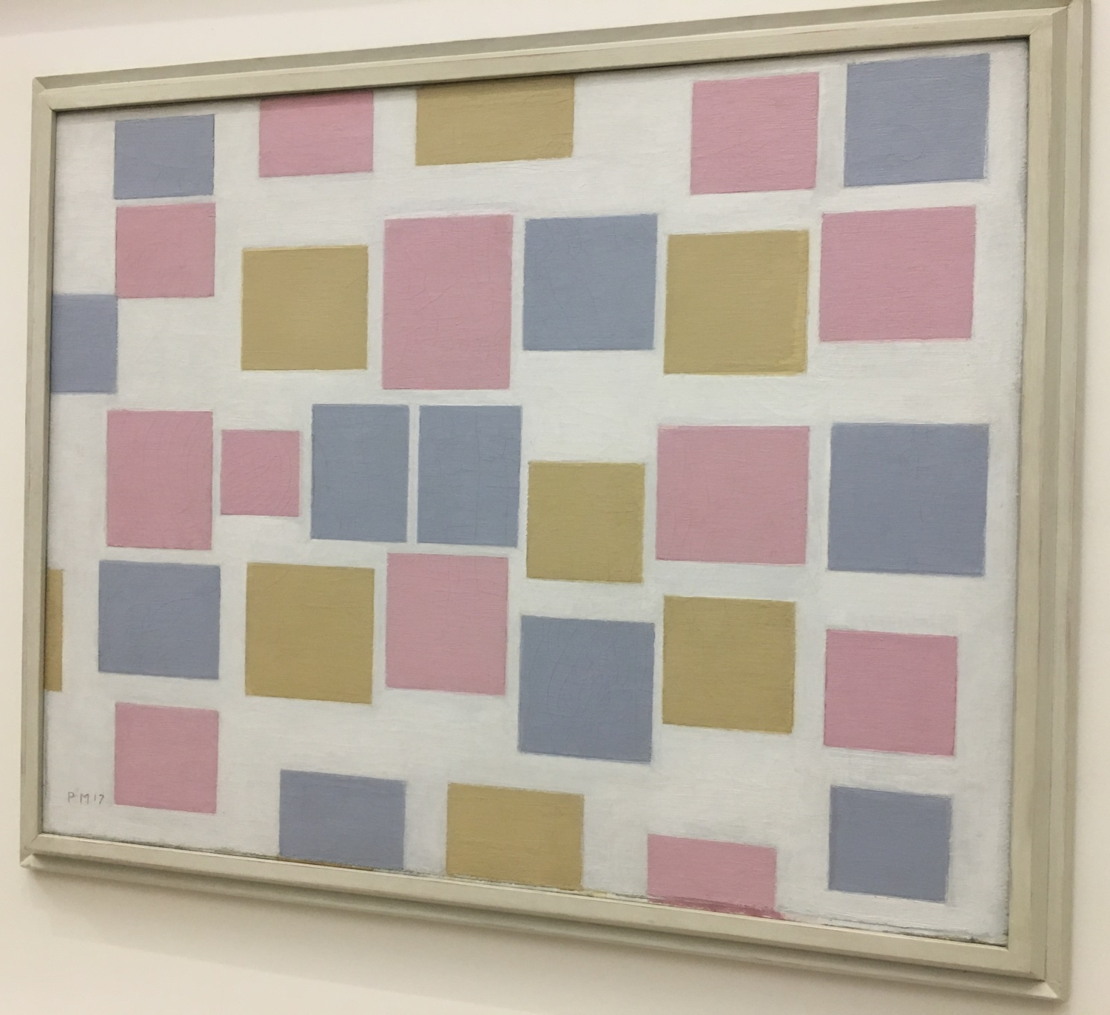
1917: Composition No. 3 with colour planes

Slide 21
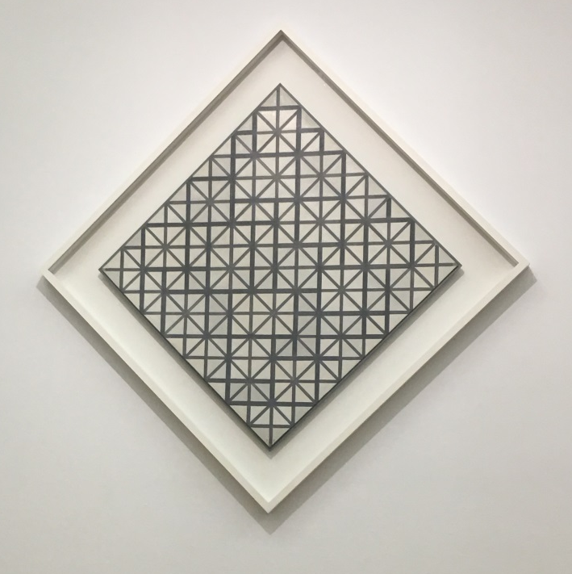
1919: Composition with grey lines

Slide 22
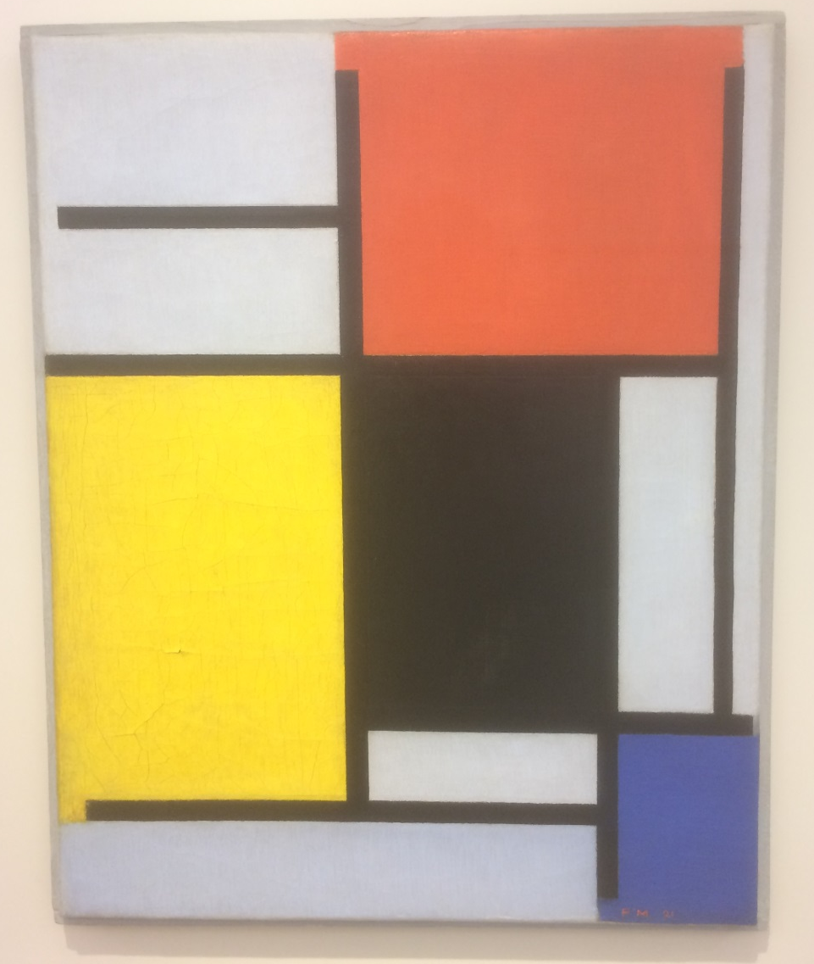
1921: Composition with red, black, yellow, blue and grey

Slide 23
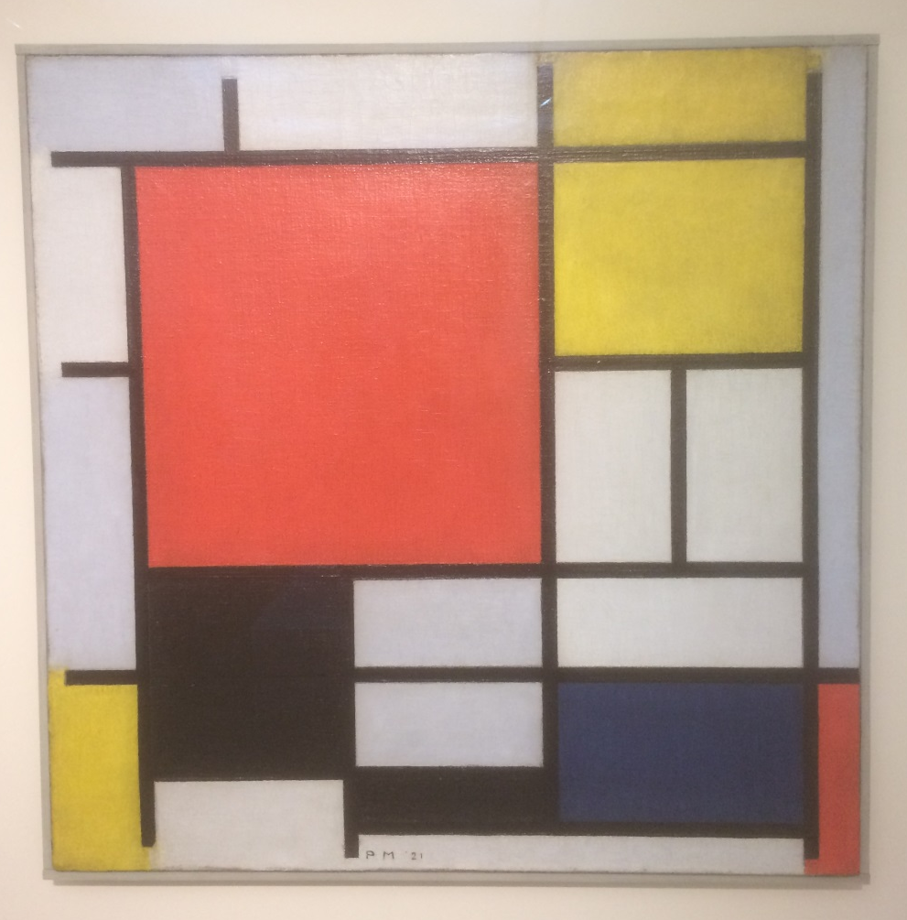
1921: Composition with large red plane, yellow, black, grey and blue

Slide 24
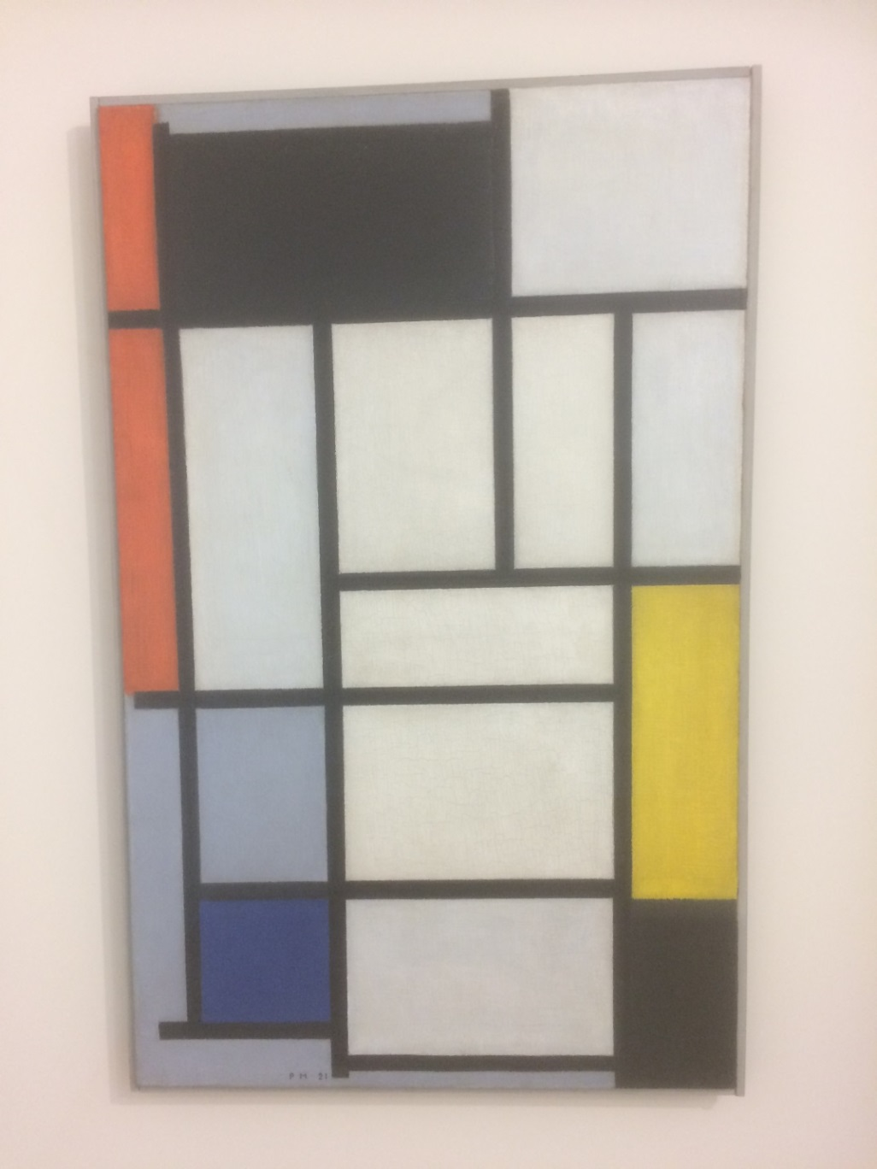
1921: Composition red, yellow, black, grey and blue

Slide 25
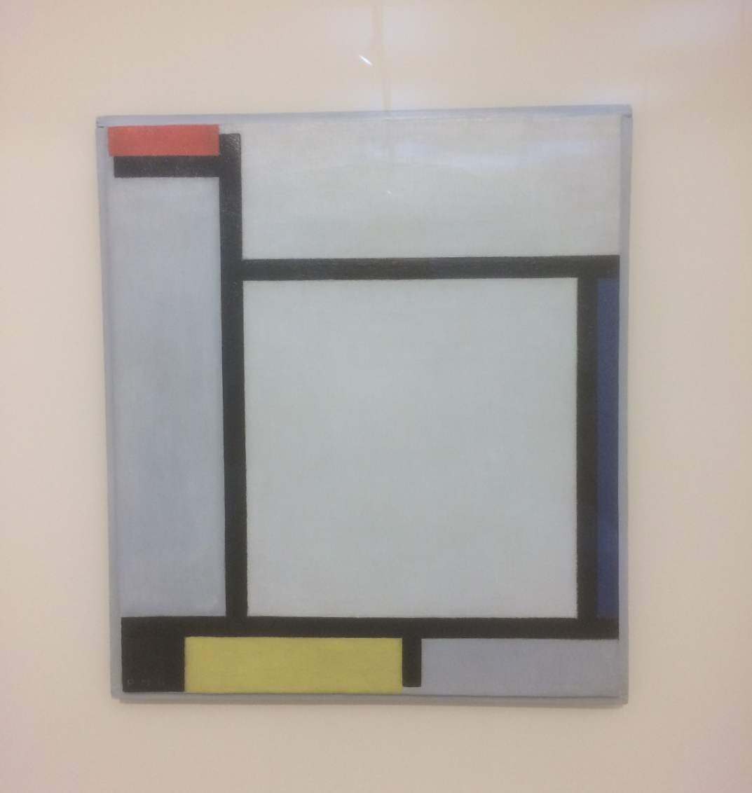
1921: Composition with red, black, yellow, blue and grey (2)

Slide 26
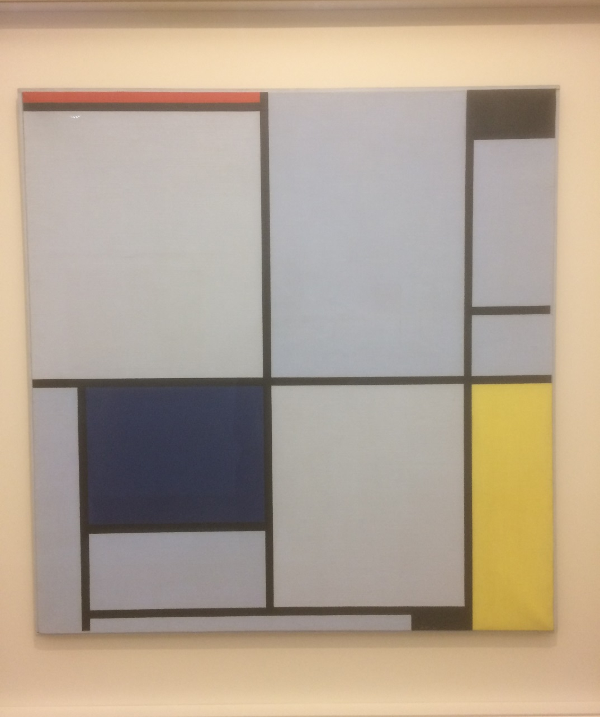
1921: Tableau 1; Painting 1

Slide 27
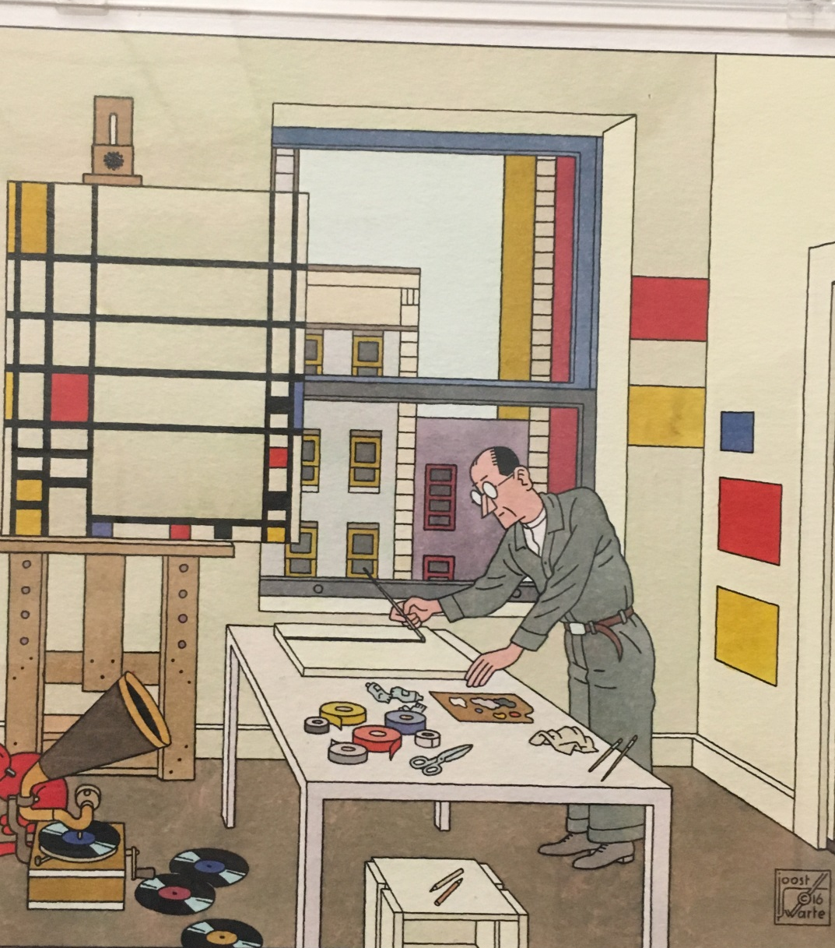
2017: Picture book en Toen de Stijl, by Joost Swarte

Slide 28
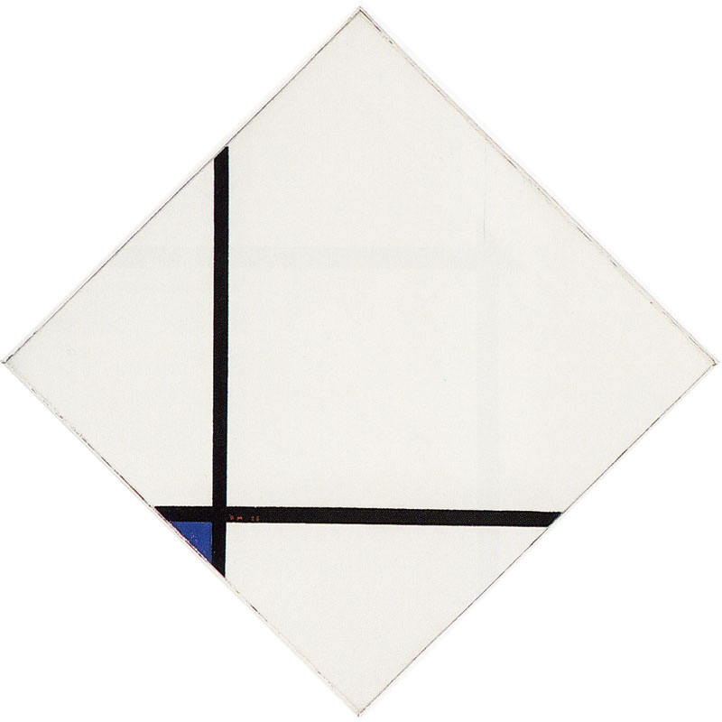
1926: Schilderij No 1: Lozenge with two lines and blue

Slide 29
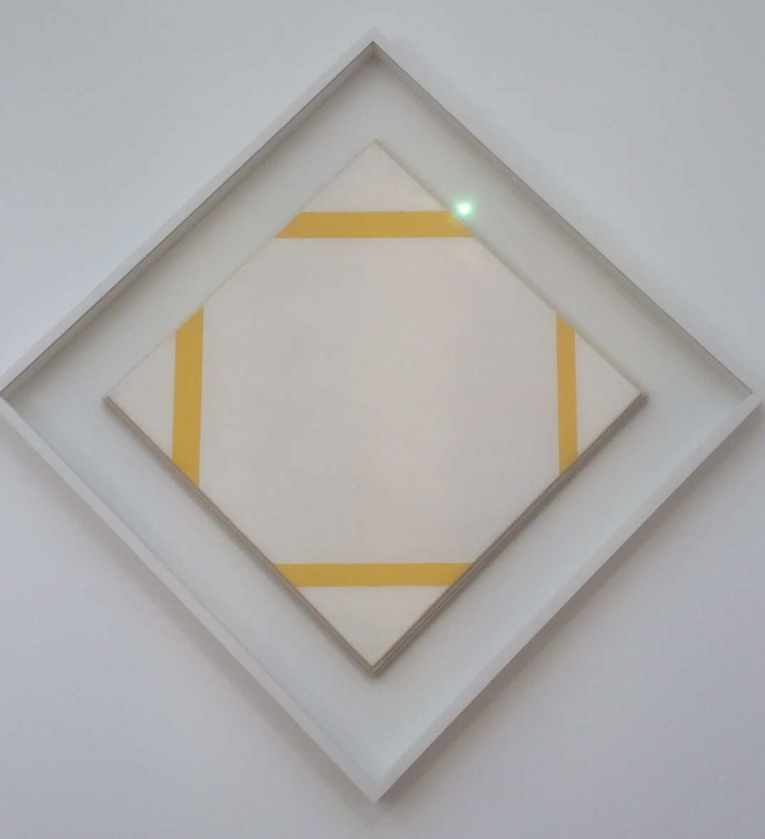
1933: Lozenge composition with yellow lines

Slide 30
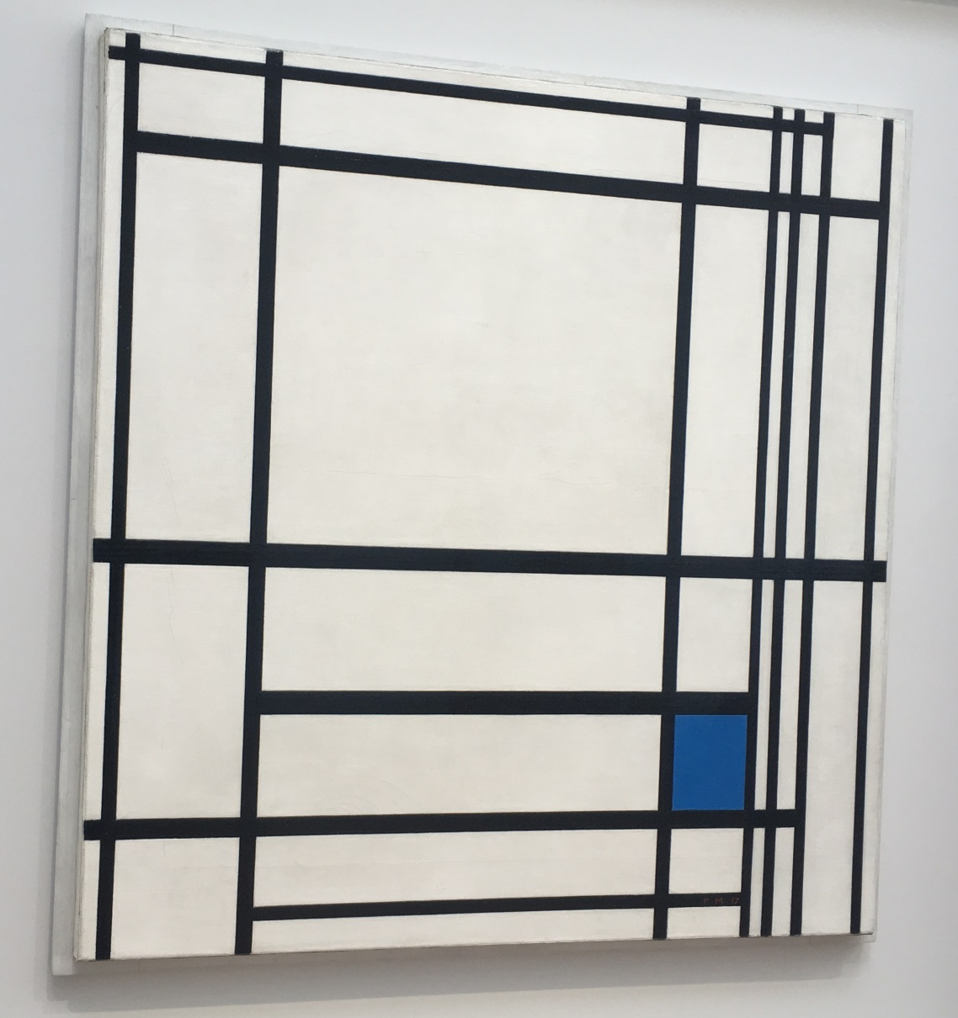
1937: Composition with lines and colour III

Slide 31
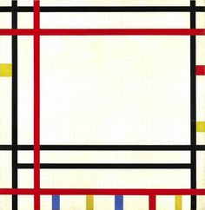
1941 - 42: New York Boogie Woogie

Slide 32
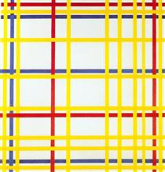
1942: New York City

Slide 33
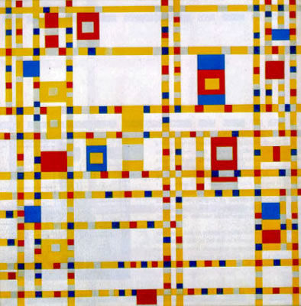
1942 - 43: Broadway Boogie Woogie

Slide 34
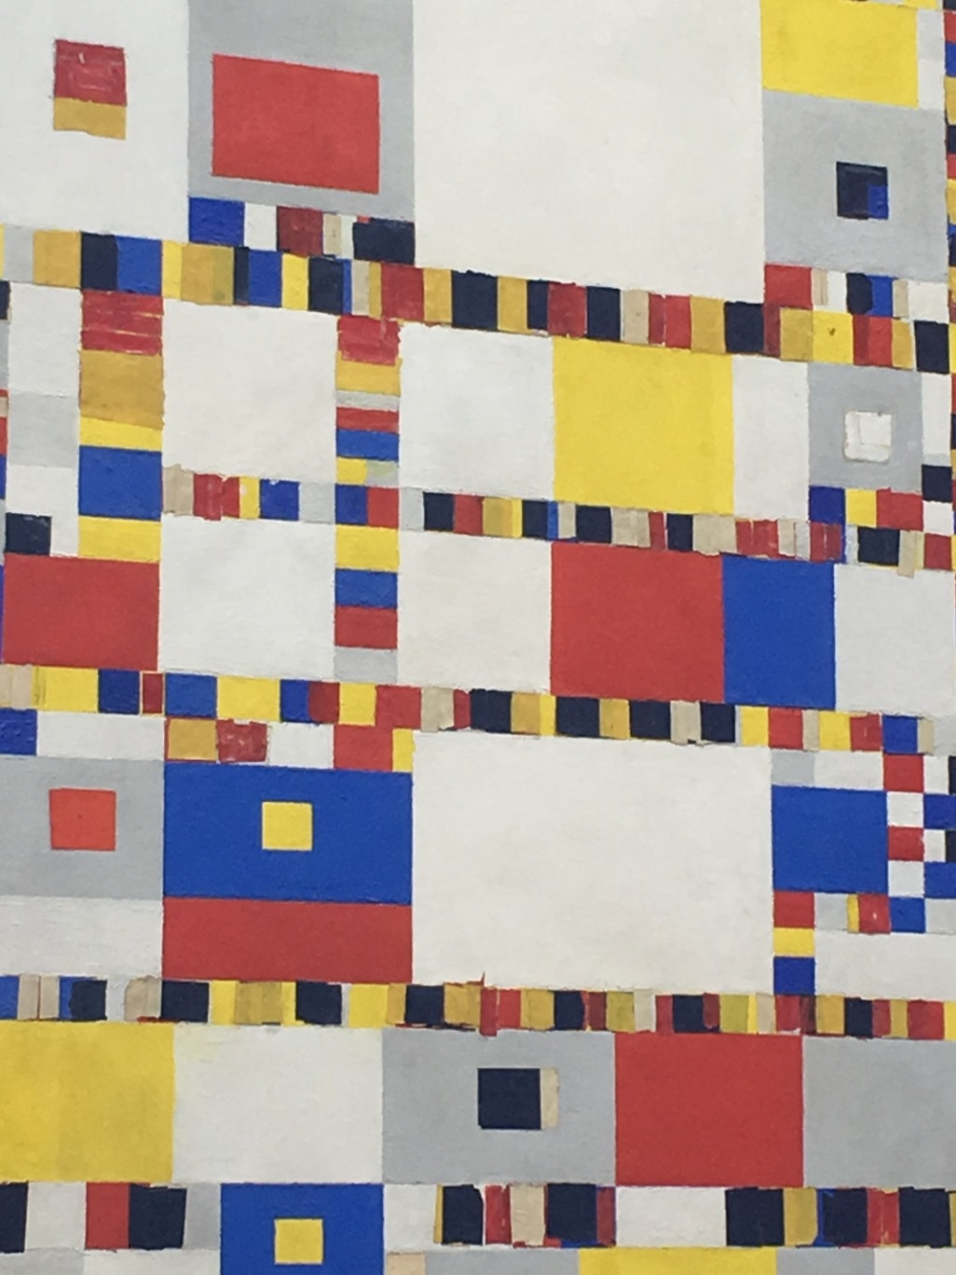
1942 - 1944: Victory Boogie Woogie

Slide 35
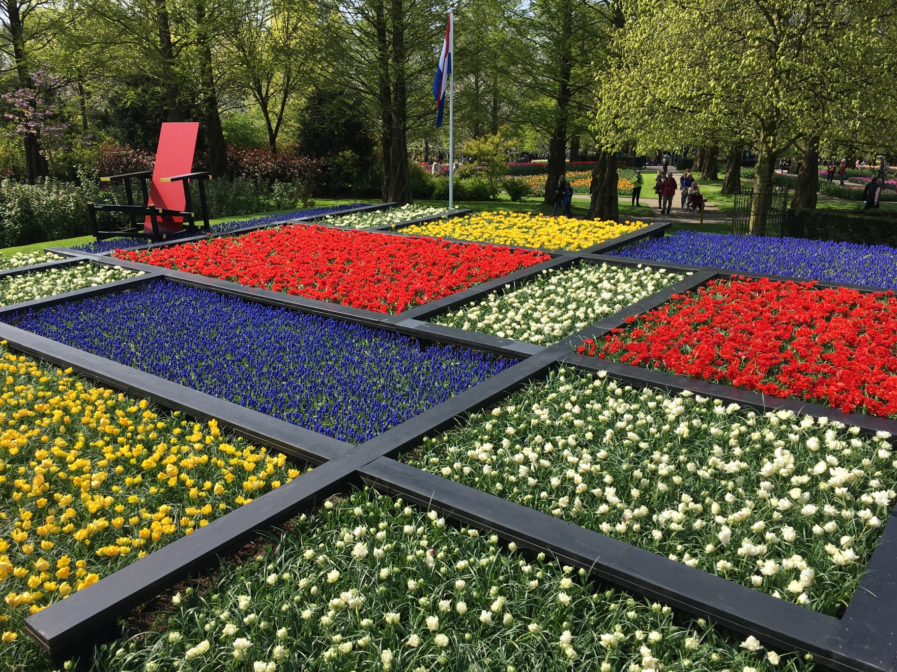
2017: Mondrian at Keukenhof

