Slide 1

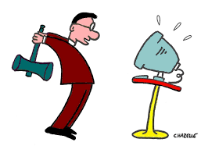
Social Media
What is IT? Should I use IT?
Prepared by Gary Tomlin for
Chalfont's U3A Computer Group

Slide 2
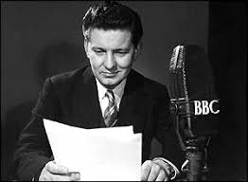
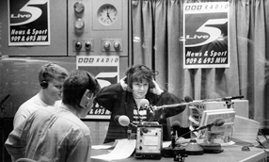
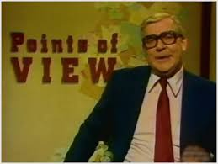
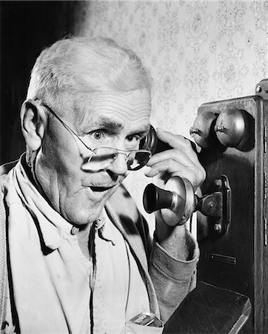
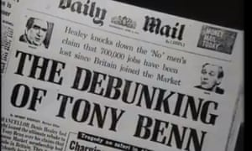
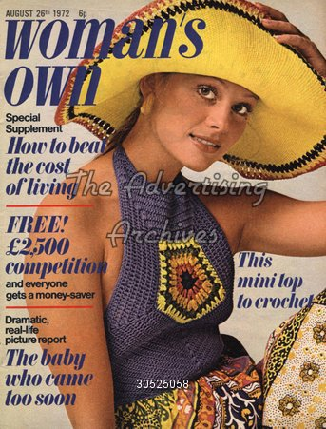
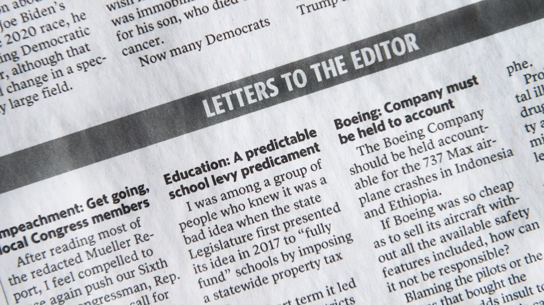
Traditional Media

Slide 3
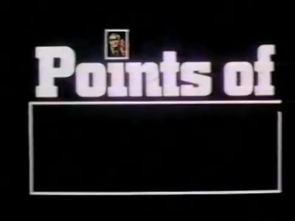

Slide 4

Email
1971: Ray Tomlinson, a computer engineer working for Bolt Beranek and Newman in Cambridge, Massachusetts, developed a system for sending messages between computers that used the @ symbol to identify addresses.
1976: Queen Elizabeth II sends an email message on Arpanet, becoming the first head of state to do so.
1997: About 10 million users world wide have free web mail accounts.
2001: Email celebrates its 30th anniversary with virtually every business in the developed world signed on.

Slide 5
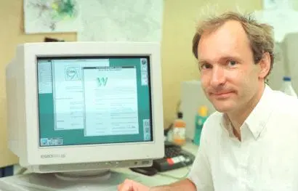
Tim Berners-Lee, a British scientist, invented the World Wide Web (WWW)
in 1989, while working at CERN

Slide 6
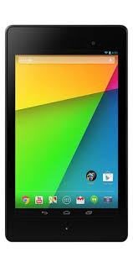
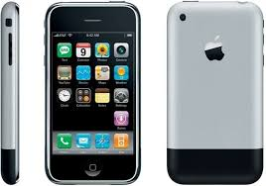
mobile computing & web 2.0
Mobile Computing is a technology that allows transmission of data, voice and video via a computer or any other wireless enabled device without having to be connected to a fixed physical link.
Web 2.0 - the second stage of development of the Internet, characterized especially by the change from static web pages to dynamic or user-generated content and the growth of social media.

Slide 7

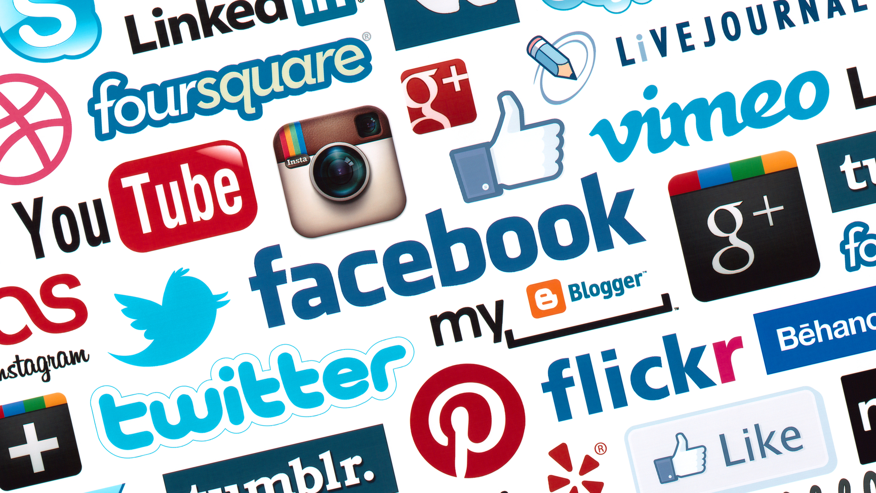
Social Media
websites and applications that enable users to create and share content or to participate in social networking

Slide 8





YouTube is a video sharing service where users can create their own profile, upload videos, watch, like and comment on other videos.
Facebook is a social networking website where users can post comments, share photographs and post links to news or other interesting or other interesting content on the web, chat live, and watch short-form video.
Pinterest is social media network that allows users to share images associated with project, goods, and services, and to visually discover new interests by browsing images others have posted
Twitter is an online news and social networking site where people communicate in short messages called tweets
WhatsApp Messenger from Facebook is a freeware, cross-platform messaging and Voice over IP service owned by Facebook. It allows users to send text messages and voice messages, make voice and video calls, and share images, documents, user locations, and other media.

Slide 9
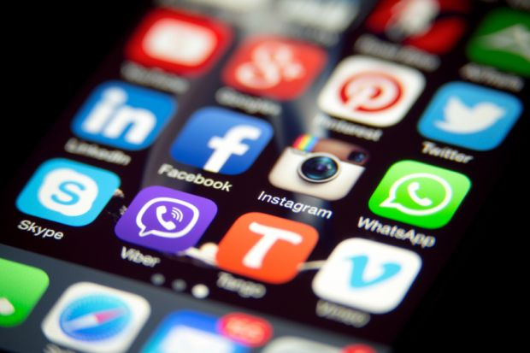
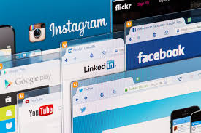
mobile apps and websites

Slide 10
Internet initialism
LOL
Laughing out loud
OMG
Oh, My God
IRL
In Real Life
BTW
By the Way
ROTFL
Rolling on the Floor Laughing
IMHO
In My Humble Opinion
AFAIK
As far as I know
WTF
What the F**k

Slide 11
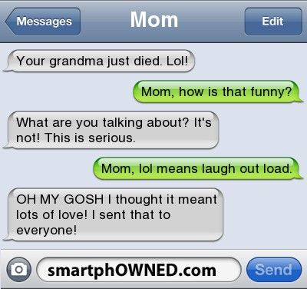
Internet initialism

Slide 12












:- ( Emoji’s / Emoticon’s :- )

Slide 13
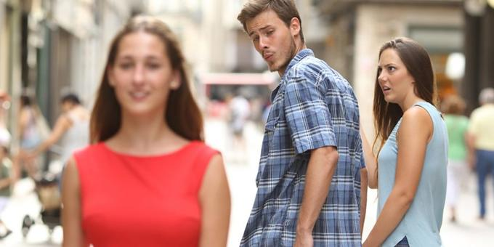
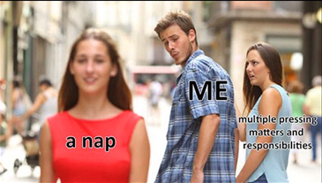
Internet Memes
An Internet meme, commonly known as just a meme (/miːm/ MEEM), is an activity, concept, catchphrase, or piece of media that spreads, often as mimicry or for humorous purposes, from person to person via the Internet. An Internet meme usually takes the form of an image (traditionally an image macro), GIF or video.

Slide 14




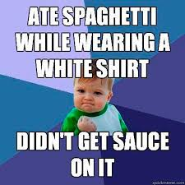
Internet Memes - Success kid

Slide 15

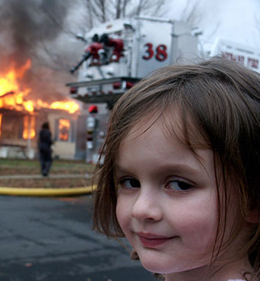
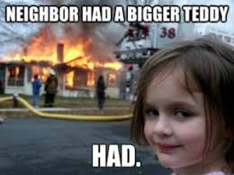
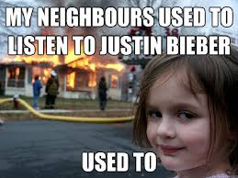
Internet Memes – Disaster Girl

Slide 16

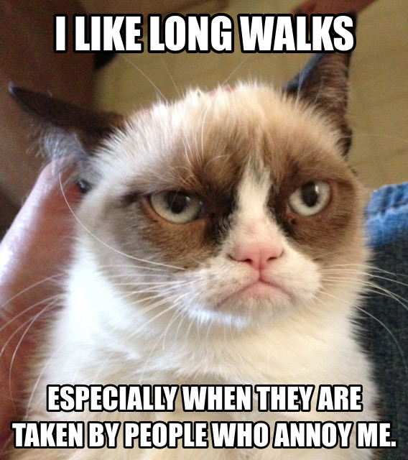



Internet Memes – Grumpy Cat

Slide 17


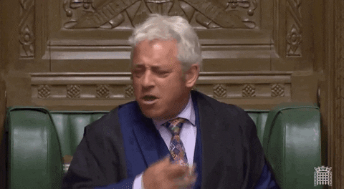
Animated Gifs

Slide 18

#hashtag
A word or phrase preceded by a hash sign (#), used on social media websites and applications, especially Twitter, to identify messages on a specific topic.

Slide 19
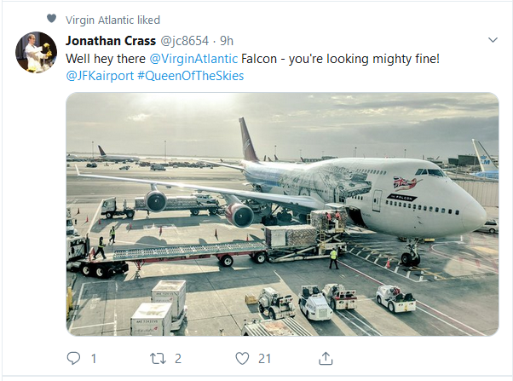
The @ Symbol
The @ symbol should be used to tag specific friends or acquaintances into your posts and photos. Use the @ symbol to notify them about posts they will want to check out. To add people into Facebook posts, just type the person's name — that will be enough to tag them

Slide 20
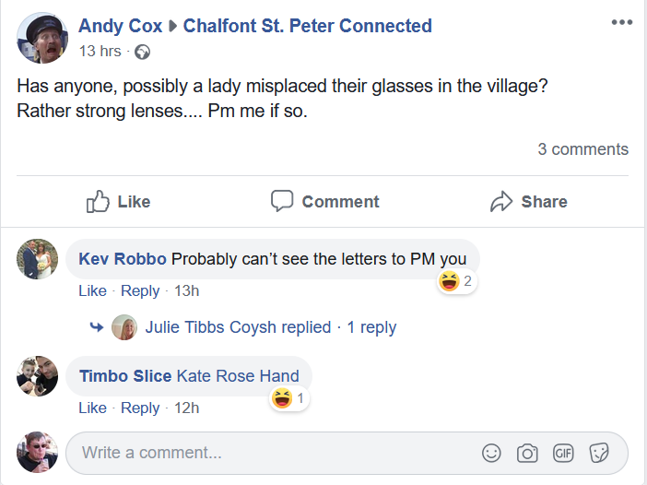
facebook
PM (Private Message) = DM (Direct Message)

Slide 21
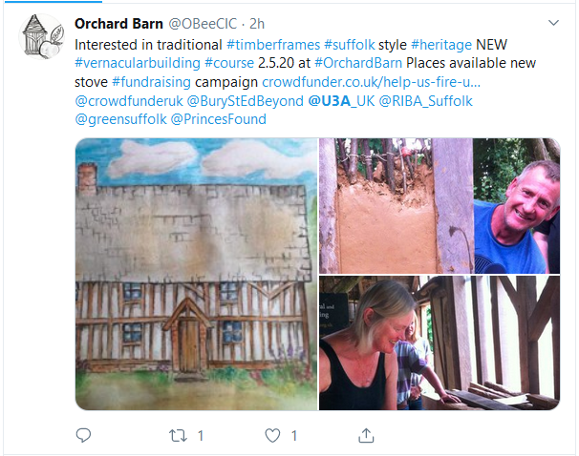
Twitter

Slide 22
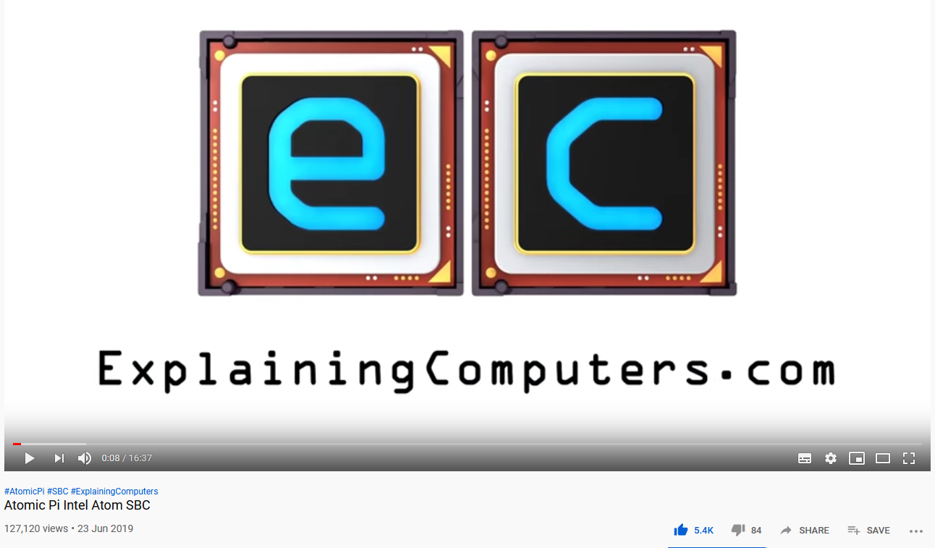
youtube

Slide 23


